Slide 1
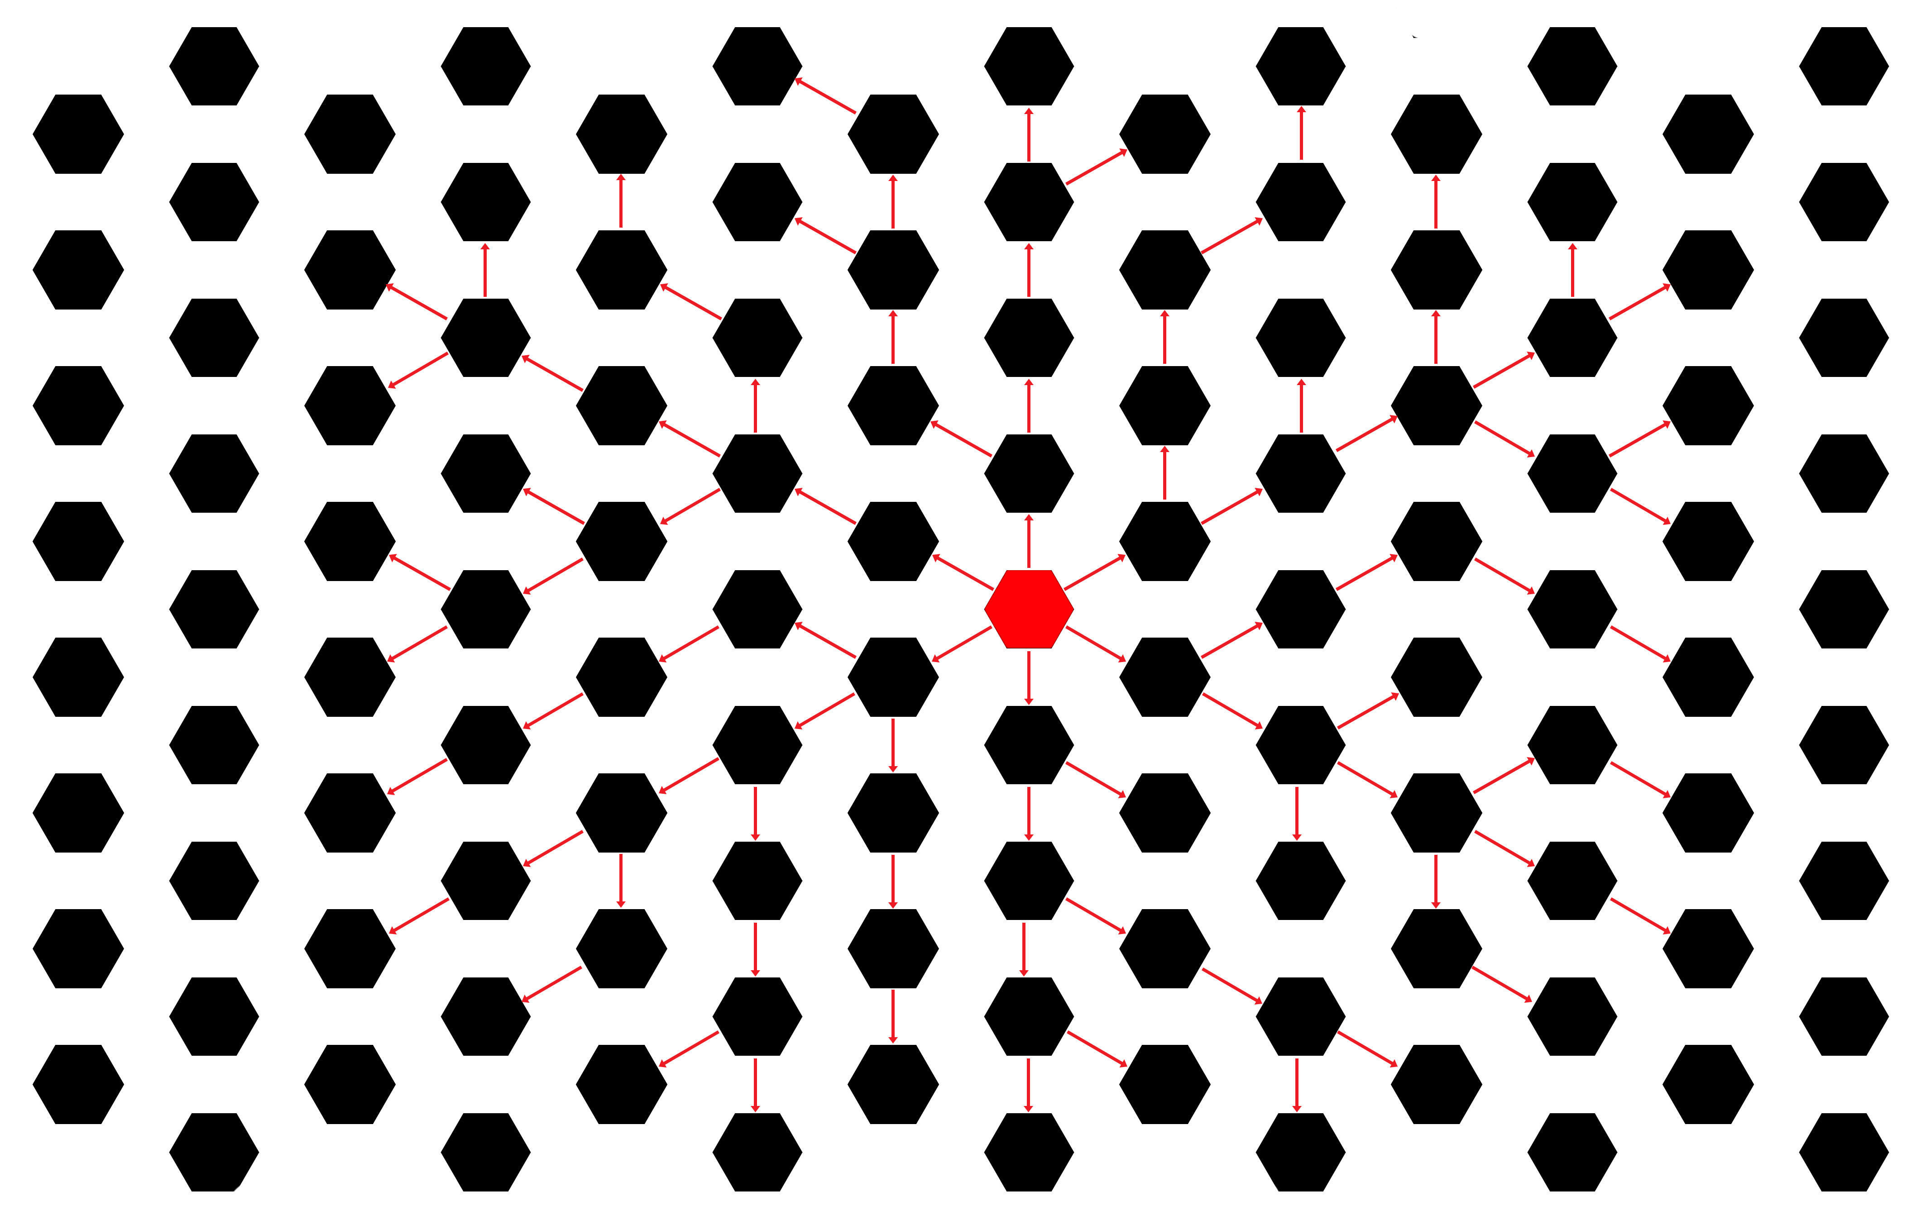
Multinode Wired Network
Information Broadcasting and Return
Nishaal Parmar – Summer 2015

Slide 2
Proposed Problem
Given any single node which is designated as the interface point of a hardwired network of identical nodes, determine an algorithm to
  Distribute data quickly and efficiently to all other nodes in the network
  Return data quickly and efficiently from any single node to the designated interface node

Slide 3
Assumptions
Network
  Wired network consists of 50-1000 nodes, with 0% packet loss when communicating information
  Network topology is not known by the master node upon startup, preventing best-route paths and broadcasting routes from being calculated in advance in a central location
Node
  Each node has an undirected interface with each of its immediate neighbors (2-way communication ability), and can recognize which of its available communication paths it is using
  Each node has an equally-efficient communication path with all of its directly connected neighbor nodes
  Each node can store a small amount of data concerning routing paths and packets seen
Data Packet
  Data packets consist of 3 parts
    TTL (1 for transmissions only to neighbor nodes)
    Unique message ID (to identify duplicated packets)
    Data content
  When receiving a packet, a node can decide to forward it (my primary concern), discard it, or process its data.

Slide 4
Unsuitable Researched Algorithms
Simple Flooding – Whenever a node receives a new packet, it transmits it to all neighbors. Fastest data propagation possible, but extremely high data overhead due to duplicate received packets.
Delayed Retransmission^{[1, 2]} – Each node independently decides whether to retransmit new packets to its neighbors with probability P based on neighbor density, signal strength, and duplicates received. In a sparse network with no packet loss, this is approximately equivalent to simple flooding.
Neighbor Information – Each node communicates with its neighbors to receive 2-hop destination lists, and determines packet rebroadcasts using this list to minimize redundancy. Each node must have a unique ID, and these protocols utilize significant overhead to communicate with their neighbors and maintain their broadcast lists. Ideal for wireless routing solutions. Examples include B.A.T.M.A.N.^{[4]} and OSLR^{[5]}.
Biologically-based routing protocols^{[3]} – ‘Ant-based’/swarm routing – Paths to a node are taken determined upon how often that path has been traveled; over time, more efficient paths are used more often than less efficient paths. Primarily designed as a solution to large, heavily interconnected networks, with an acceptable solution slowly evolving over time. Low, constant overhead, and slow convergence upon a solution.
Computer ‘tree’ pathing algorithms^{[6]} such as Bellman-Ford and Dijkstra– Assume varying path lengths and efficiencies between directly connected nodes.

Slide 5




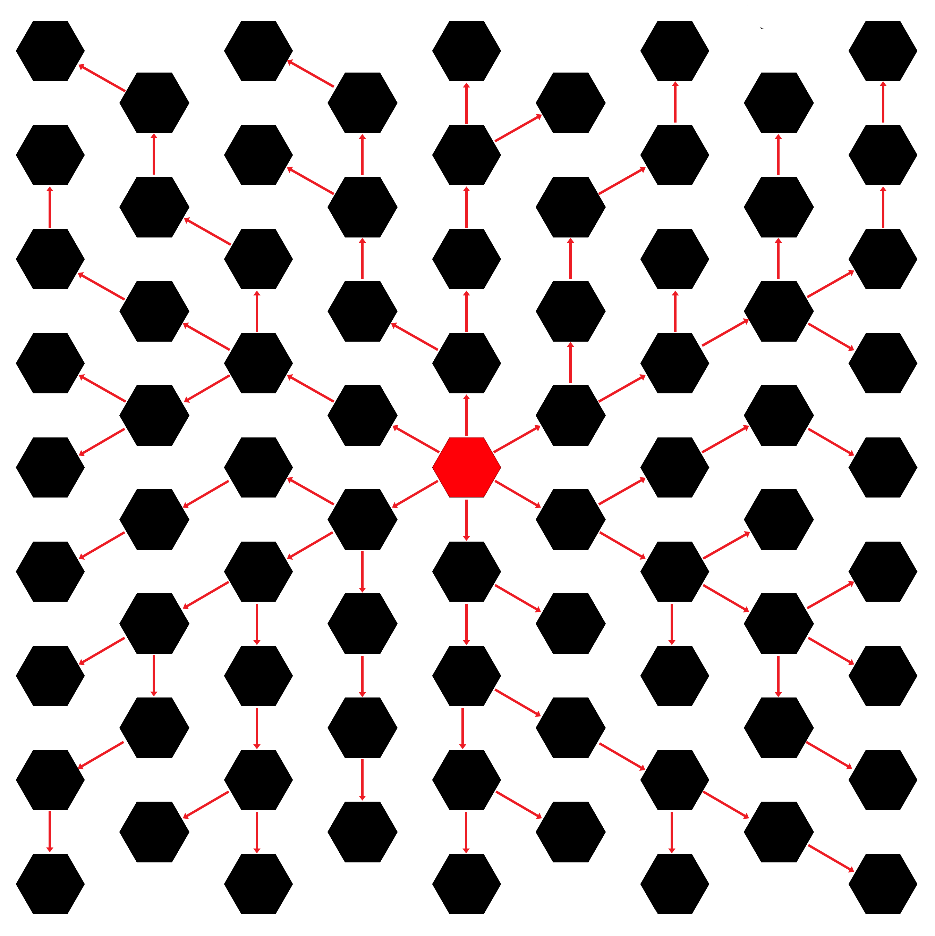
Proposed Solution:
Modified Breadth-First Search
Master node broadcasts table reset request to all connected nodes, adds all connected nodes to its transmitter table
Upon receiving a unique table reset request, a node designates the node the request was made from as its designated transmitter node, forwards the request to all other connected nodes, and adds all nodes to its routing table.
Upon receiving a duplicate table reset request, a node requests that the transmitting node remove it from the transmitting node’s routing table
Once the routing table is set up, an optimized broadcast path is created where each node is receiving data from only a single other node, and transmitting to any number of directly connected nodes, forming a least-spanning tree.

Slide 6

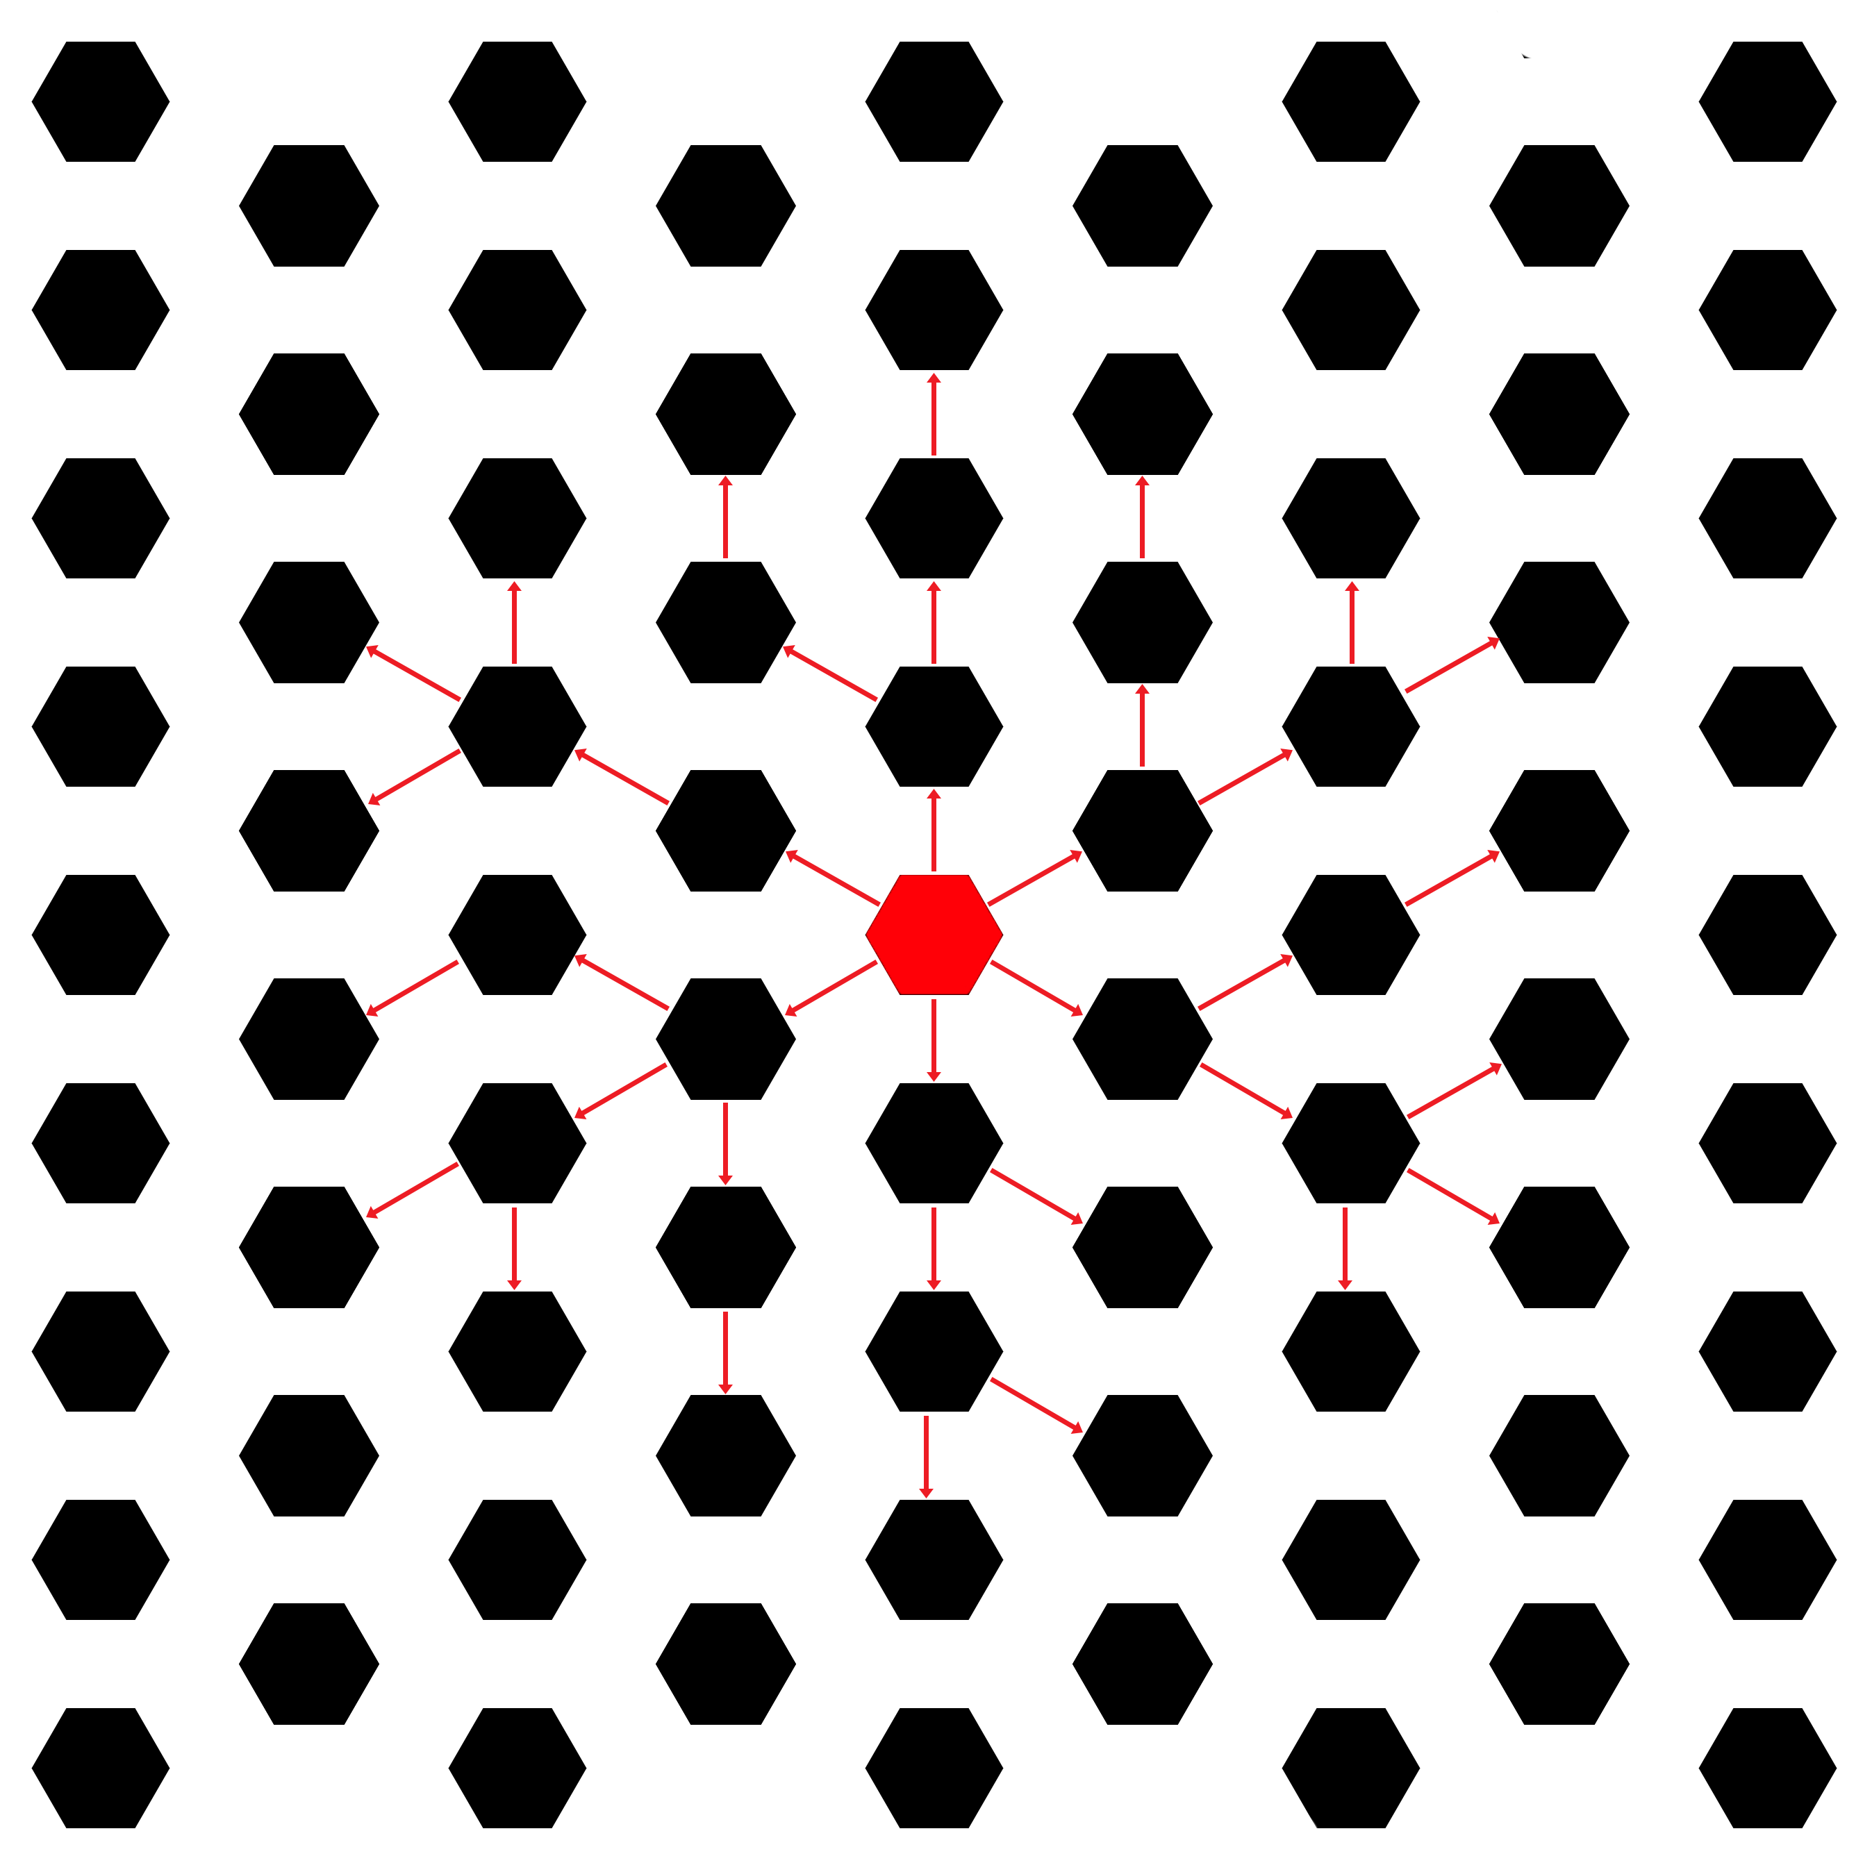
Proposed Solution:
Network Topology Known in Advance
Master node adds all connected nodes to its broadcast table, adds them to list of previously handled nodes.
All nodes, upon being added for the first time, add any connected nodes not previously handled to their broadcast tables, and add those nodes to the list of previously handled nodes
The least-spanning tree created expands outward one ‘hop’ at a time
Once the routing table is set up, an optimized broadcast path is created where each node is receiving data from only a single other node, and transmitting to any number of directly connected nodes.

Slide 7
Inverse Problem: Satellite node to output
Once a routing table has been set up, this problem is trivialized, as an optimal route exists from the master node to any given satellite node.
To access the master node via an optimized path, each node simply needs to send the desired data through to its designated transmitter node. The node without a designated transmitter node will be the output (master) node.
Speed: Optimal (least-hop paths from all nodes)
Efficiency: Optimal – no duplicate packets received

Slide 8
Efficiency, Speed, and Disadvantages
Routing table setup speed: Optimal approx. O(N).
Routing Table setup efficiency: same as simple flooding (non-optimal), onetime cost
Broadcast/Inverse Speed: Optimal (least-hop paths to all nodes)
Broadcast/Inverse Efficiency: Optimal; least-spanning tree; 0 duplicaion
Adding or Removing Nodes
  When adding or removing a node, a routing table reset signal would need to be requested and sent from the master node, requesting that all existing routing table data be flushed and a new breadth-first routing table be generated.
  Unexpected removal of a node (i.e. suddenly physically yanking a module off) would result in signal loss until a routing error packet is received by the master node from the removed node’s designated transmitting neighbor and a routing table reset signal is sent to rebuild the network.

Slide 9
Secondary Considerations
Broadcast request originating from satellite node
  Treated the same as any other broadcast request, each node forwards the packet to all other nodes in its routing table
  Time to complete: Near Optimal: up to twice as long as master-node-originating broadcasts depending on satellite node distance from master node
  Efficiency: Optimal – no duplicate broadcast packets
Master node communication routing to a specific satellite node
  Each node is assumed to have a unique ID
  As a final step in routing table setup, each node would transmit the node ID of its designated transmitter node to the master node, which would then store this optimal route to each satellite node in its memory. A total minimum number of routes corresponding to the total number of endpoint nodes would need to be stored in the master node, with complete routing information contained within each packet. Alternatively, this routing table could be distributed among all nodes instead, with each node, including the master node, needing only a Nx2 table indicating the ideal immediate forwarding node necessary for each destination node in an optimal path. Each packet would only need to contain the destination node ID, with no routing information required.
  Time to complete: Optimal: stored path for each node is an optimal route
  Efficiency: Optimal – no duplicate broadcast packets

Slide 10
Secondary Considerations (contd.)
Satellite node to satellite node communication
  All nodes assumed to have a unique ID, master node assumed to have optimal routing table to each node (as above)
  All node-to-node communication would be routed to the master node, which would assign it an optimal routing path to its final destination once received.
  Speed: up to O(V+E) depending on source and destination distance from
  master node, and relative positions within the routing tree
  Efficiency: Optimal – no duplicate packets received by any node
  Slow, and potentially bandwith-limiting for multiple simultaneous requests, as all
  such requests must be routed through the master node
  Disadvantages could be partially mitigated by having all nodes locally store
  optimized 2-hop neighbor routes, and use these routes for communication
  between appropriately close neighbor nodes.

Slide 11
Optimizing Paths for all node-pairs
Each node could initiate and store data from its own breadth-first request to construct a similar least-spanning tree to the one used by the master node
  Each satellite node would be required to have a unique ID, and store a matrix, of maximum size Nx2, consisting of the optimal forwarding link to each destination node. A separate table for node-based broadcasts of Nx6 would need to be constructed from this data for node-based broadcast requests
  Node-to-node packets only have to contain the destination node’s ID rather than full routing data – Broadcast packets would need to transmit the origin node ID, but neither the destination ID nor any routing data would be required – Any single node would only ever need to store 1-hop routing tables for the chosen optimal transmission paths it was a non-endpoint member of
  Additional setup time would be required, growing with the number of nodes in the network
  Each node in the network would have an optimal path to every other node in the network, increasing efficiency and speed
  Node-to-node communications would no longer be required to be routed through the master node
  Node-based broadcasts would always follow an optimal least-spanning tree
  Setup time: approx. O(N²)

Slide 12
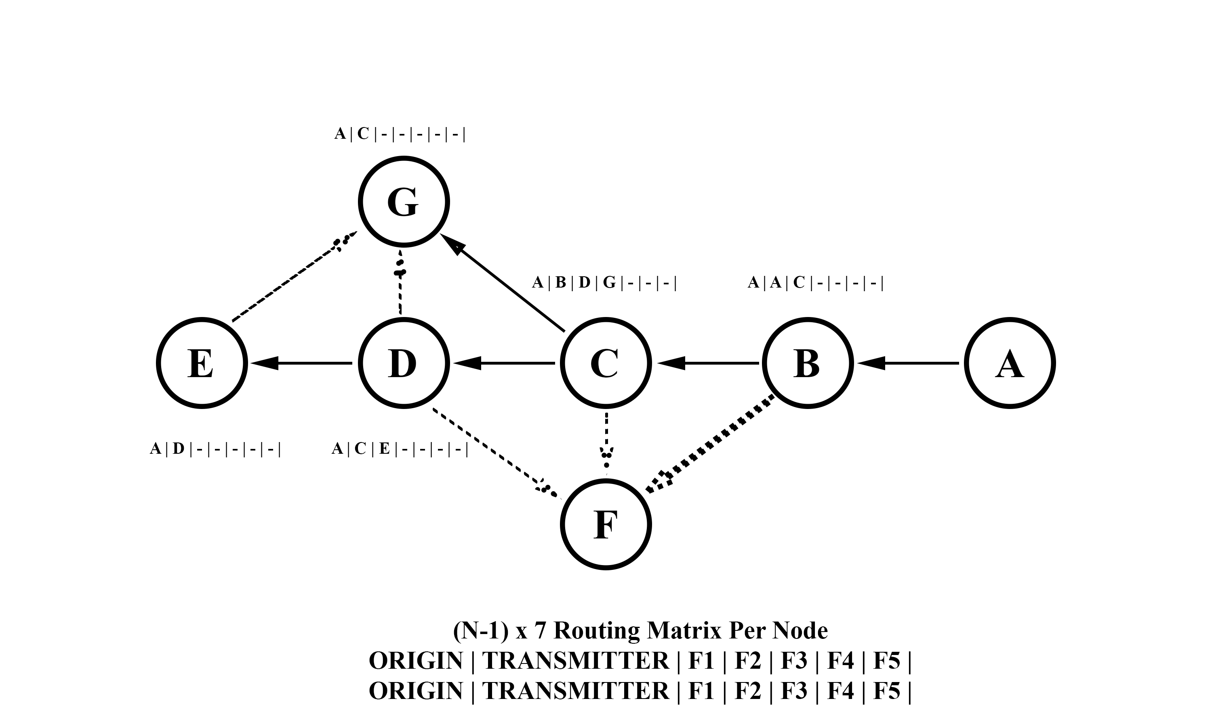
Distributed Routing Tables

Slide 13
Works Referenced
Lin, Ying-Dar, et al. "Realizing and benchmarking broadcast algorithms in wireless mesh networks." Computer Communications 34.10 (2011): 1169-1181.
Abdulai, Jamal-Deen, Mohamed Ould-Khaoua, and Lewis M. Mackenzie. "Adjusted probabilistic route discovery in mobile ad hoc networks." Computers & Electrical Engineering 35.1 (2009): 168-182.
Torres, Claudio E., et al. "Modeling, analysis and simulation of ant-based network routing protocols." Swarm Intelligence 4.3 (2010): 221-244.
Jacquet, Philippe, et al. "Optimized link state routing protocol for ad hoc networks." Multi Topic Conference, 2001. IEEE INMIC 2001. Technology for the 21st Century. Proceedings. IEEE International. IEEE, 2001.
Performance analysis of the BATMAN wireless ad-hoc network routing protocol with mobility and directional antennas
Demaine, Erik, and Devadas, Srini, 6.006 Introduction to Algorithms, Fall 2011. Lectures 13, 16, 17 (Massachusetts Institute of Technology: MIT OpenCourseWare), http://ocw.mit.edu/6-006F11 (Accessed May 26, 2015). License: Creative Commons BY-NC-SA
Works Consulted
Awerbuch, Baruch, David Holmer, and Herbert Rubens. "High throughput route selection in multi-rate ad hoc wireless networks." Wireless On-Demand Network Systems. Springer Berlin Heidelberg, 2004. 253-270.
De Couto, Douglas SJ, et al. "A high-throughput path metric for multi-hop wireless routing." Wireless Networks 11.4 (2005): 419-434.
Draves, Richard, Jitendra Padhye, and Brian Zill. "Routing in multi-radio, multi-hop wireless mesh networks." Proceedings of the 10th annual international conference on Mobile computing and networking. ACM, 2004.
Goff, Tom, et al. "Preemptive routing in ad hoc networks." Proceedings of the 7th annual international conference on Mobile computing and networking. ACM, 2001.
Hanashi, Abdalla M., et al. "Performance evaluation of dynamic probabilistic broadcasting for flooding in mobile ad hoc networks." Simulation Modelling Practice and Theory 17.2 (2009): 364-375.
Hu, Yih-Chun, and David B. Johnson. "Design and demonstration of live audio and video over multihop wireless ad hoc networks." MILCOM 2002. Proceedings. Vol. 2. IEEE, 2002.
Johnson, David, Ntsibane Ntlatlapa, and Corinna Aichele. "Simple pragmatic approach to mesh routing using BATMAN." (2008).
Lim, Hyojun, and Chongkwon Kim. "Flooding in wireless ad hoc networks." Computer Communications 24.3 (2001): 353-363.
Lou, Wei, and Jie Wu. "On reducing broadcast redundancy in ad hoc wireless networks." System Sciences, 2003. Proceedings of the 36th Annual Hawaii International Conference on. IEEE, 2003.
Peng, Wei, and Xi-Cheng Lu. "On the reduction of broadcast redundancy in mobile ad hoc networks." Proceedings of the 1st ACM international symposium on Mobile ad hoc networking & computing. IEEE Press, 2000.
Xiao, Zhen, and Kenneth P. Birman. "A randomized error recovery algorithm for reliable multicast." INFOCOM 2001. Twentieth Annual Joint Conference of the IEEE Computer and Communications Societies. Proceedings. IEEE. Vol. 1. IEEE, 2001.
Zhang, Qi, and Dharma P. Agrawal. "Dynamic probabilistic broadcasting in MANETs." Journal of Parallel and Distributed Computing 65.2 (2005): 220-233.

